Slide 1
Wiring the Future: Building a Cisco Packet Tracer Network for Universities

Slide 2
Introduction
Designing the Network Topology
Configuring Network Devices
Testing and Troubleshooting the Network
Benefits of Implementing a University Network using Cisco Packet Tracer
Conclusion

Slide 3

Introduction
In today's digital age, networking has become an integral part of every organization. Universities are no exception to this trend. A university network is a complex system that connects various departments, faculties, and research centers. The implementation of a university network using Cisco Packet Tracer is an effective way to manage the network infrastructure.
Cisco Packet Tracer is a powerful network simulation tool that allows users to design, configure, and troubleshoot networks in a virtual environment. It provides a safe and cost-effective way to test network configurations before deploying them in the real world

Slide 4
Designing the Network Topology
The first step in implementing a university network using Cisco Packet Tracer is to design the network topology. This involves identifying the different network segments, such as the core, distribution, and access layers, and determining how they will be connected. The topology should be designed to provide optimal performance, scalability, and security.
Once the topology has been designed, it can be implemented in Cisco Packet Tracer by adding devices, configuring interfaces, and setting up routing protocols. This process requires a good understanding of network protocols and configurations

Slide 5
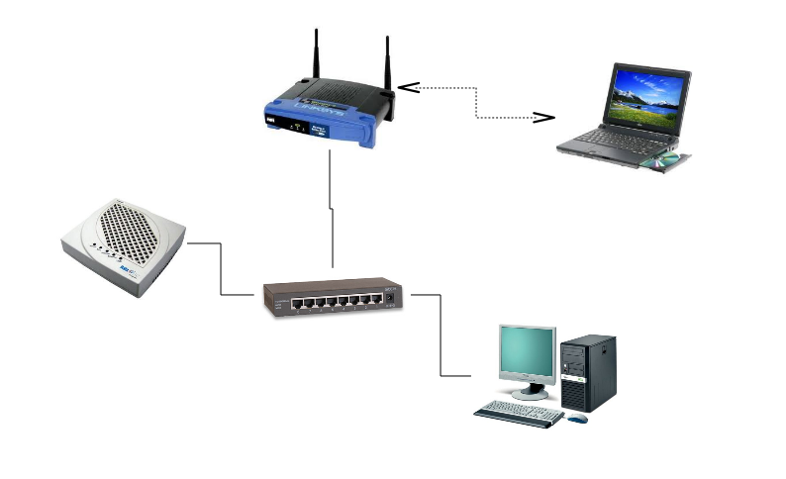
Configuring Network Devices
After designing the network topology, the next step is to configure the network devices. This includes setting up IP addresses, configuring VLANs, and enabling routing protocols. Cisco Packet Tracer provides a user-friendly interface for configuring network devices, making it easy to set up complex network configurations.
In addition to basic configuration, advanced features such as Quality of Service (QoS), Virtual Private Networks (VPNs), and Access Control Lists (ACLs) can also be configured in Cisco Packet Tracer. These features help to ensure that the network is secure and performs optimally.

Slide 6
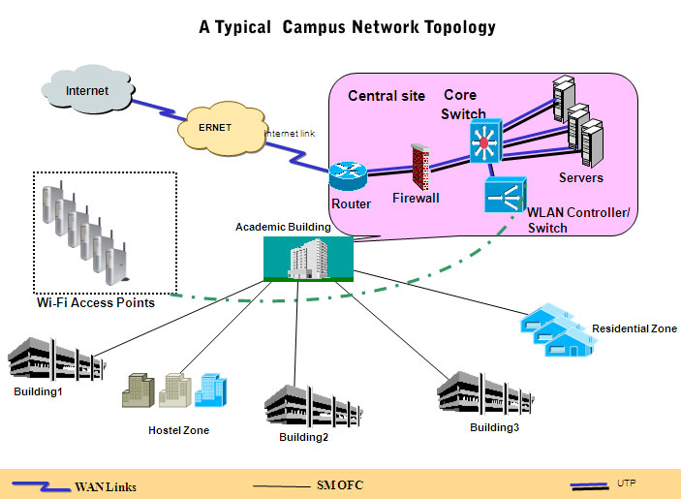

Slide 7
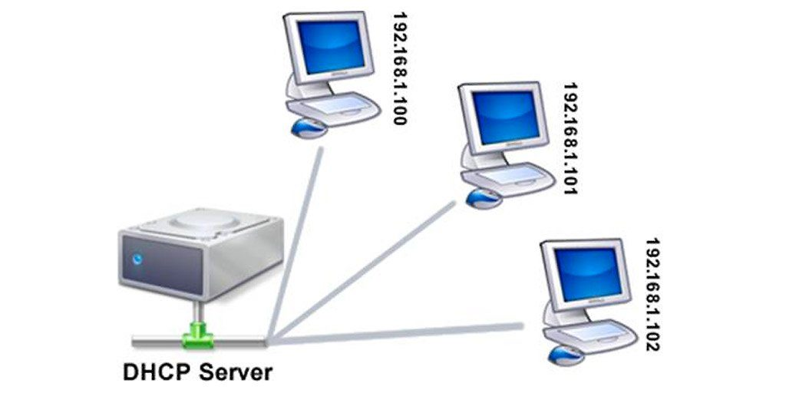
A network consisting of 4 net DHCP
A network consisting of 4 net DHCP (Dynamic Host Configuration Protocol) refers to a network infrastructure that uses DHCP to automatically assign IP addresses to devices connected to the network. In this setup, the network is divided into four subnets, each of which is allocated a range of IP addresses that can be assigned to devices on that subnet.
DHCP is a protocol that enables automatic IP address configuration for devices on a network. It allows devices to obtain IP addresses, subnet masks, default gateways, and other network configuration information without manual configuration. This makes it easier to manage a large number of devices on a network and ensures that each device is assigned a unique IP address.
Overall, a network consisting of 4 net DHCP is a flexible and efficient way to manage IP address allocation in a complex network environment. It allows network administrators to easily manage a large number of devices and ensure that each device is assigned a unique and appropriate IP address.

Slide 8
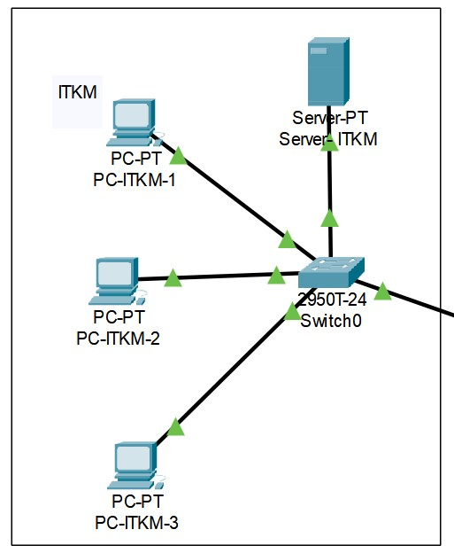
One of them was connected to itkm
When one of the subnets is connected to the "itmk in university network," this means that there is a link between the two networks, allowing devices on the subnets to communicate with devices on the larger university network. This link may be established using a router or switch, which is responsible for routing traffic between the subnets and the larger network.
Overall, the use of DHCP and the connection to the university network suggest that this network is designed to support a large number of devices and users and that it is part of a larger infrastructure that provides connectivity and services to the university community.

Slide 9

In a university communication network, OSPF would be one of several protocols used to facilitate communication between different devices and systems. For example, it may be used to route traffic between different departments to enable communication between different types of devices (such as computers, servers, and printers).
Overall, OSPF is an important tool for ensuring efficient and reliable data transmission within large and complex networks, such as those found in universities and other large organizations.

Slide 10
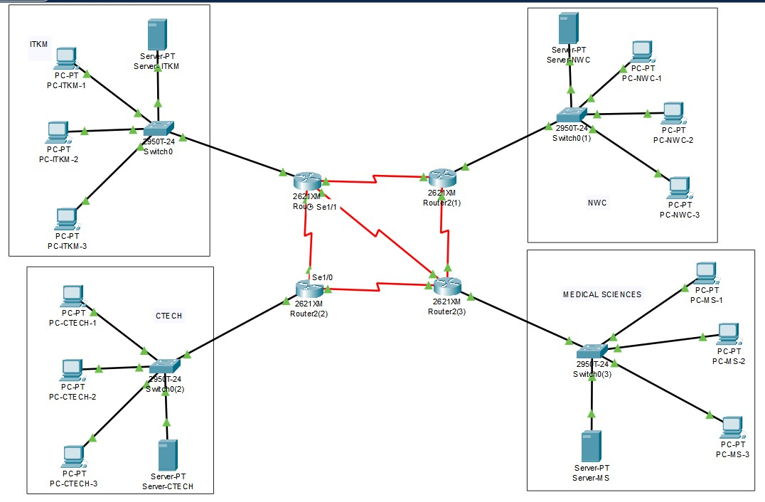

Slide 11

Testing and Troubleshooting the Network
Once the network has been configured, it is important to test and troubleshoot it to ensure that it is functioning as expected. Cisco Packet Tracer provides a range of tools for testing and troubleshooting network configurations, including packet tracer, ping, and traceroute.
If any issues are identified during testing, they can be addressed by using the troubleshooting tools provided in Cisco Packet Tracer. These tools allow users to identify and resolve network problems quickly and efficiently

Slide 12
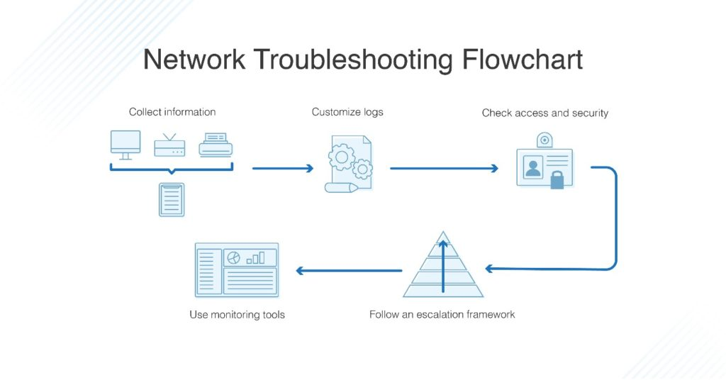

Slide 13
Benefits of Implementing a University Network using Cisco Packet Tracer
Implementing a university network using Cisco Packet Tracer offers several benefits. Firstly, it provides a safe and cost-effective way to test network configurations before deploying them in the real world. This helps to reduce the risk of downtime and ensures that the network performs optimally.
Secondly, Cisco Packet Tracer is a user-friendly tool that requires minimal training to use. This makes it accessible to a wide range of users, including students and faculty members who may not have extensive networking experience. Finally, implementing a university network using Cisco Packet Tracer helps to ensure that the network is secure and meets the needs of the university's diverse user base.

Slide 14
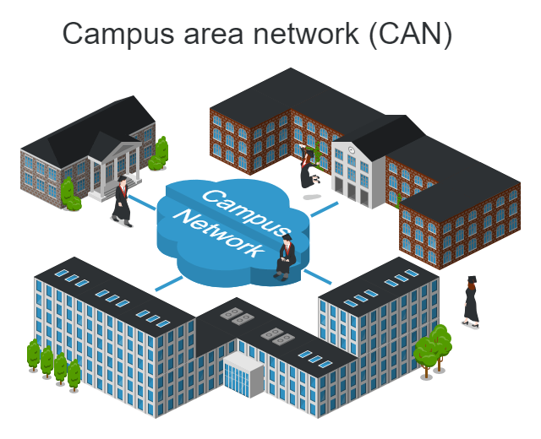
Conclusion
In conclusion, implementing a university network using Cisco Packet Tracer is an effective way to manage the network infrastructure. It provides a safe and cost-effective way to test network configurations, while also ensuring optimal performance and security. By following the steps outlined in this presentation, universities can create a robust and reliable network infrastructure that meets the needs of their users.
With its user-friendly interface and powerful features, Cisco Packet Tracer is an essential tool for anyone involved in designing, configuring, or troubleshooting network infrastructures.

